Slide 1
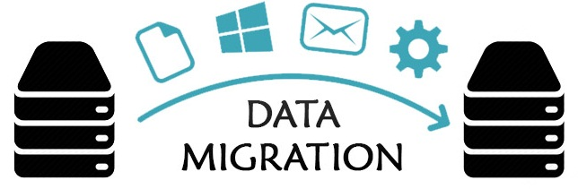




DATABASE
MIGRATION
A software program for migrating databases across MySQL and PostgreSQL RDBMSs’
Abrahamyan Silvia
Arevshatyan Ani
Notes:
barev dzez es … es … mer projecty naxatesvac e tarber relacion databazaneri karavarman
hamakargeri mijev tvyalneri sxemaner texapoxelu hamar; arayjm menq irakanacnum enq
ayd gorcyntacy MySQL ev postgreSQL Rdbms.neri hamar

Slide 2
Contents
Introduction
How the program works
Software development process
Technologies used
The final product
Further development
Notes:
Nerkayacman yntacqum xoselu enq Databazaneri migraciayi anhrajeshtutyan depqeri,
katarman gorcyntaci, mer projectum xndri lucman tarberaki, ogtagorcvac texnologianeri
ev projecti zargacman puleri masin

Slide 3

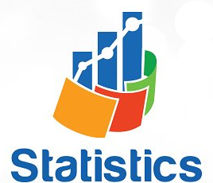


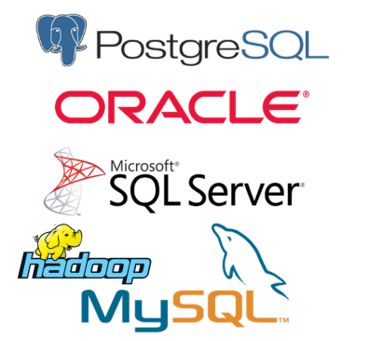







Introduction
Notes:
hachax anhrajesht e linum poxanakel mec qanakutyamb tarber tvyalner.
Aydpisi anhrajeshtutyun ka hatkapes IT volortum
.. orinak
. ete kazmakerputyuny voroshuma poxel rdbms.n => petqa hin bazayic tvyalnery petq e texapoxven nori mej
. orinak vichakagrakan (statistica) tvyalner havaqox kazmakerputyunnery kariq unen vercnelu tvyalner
tarber kazmakerputyunneri taratesak rdbms.neric
Ayspisi iravichakneri hamar anhrajesht e amboxjakan miasnakan hamakarg vory kiragorci bolor texapoxutyunnery:
Ays xndri lucman hamar henc mshakvel ev mshakvelu e ays proekty:
Arayjm naxagci naxnakan tarberakum irakanacvac en MySql ev Postgres rdbmsneri mijev poxadardz texapoxum;

Slide 4
How the program workS
PostgreSQL type schema
MySQL type schema
Tables Columns
Relations
Tables Columns
Relations
Convert
Selecting tables
Apply /implement
Analyze
Notes:
Inchpes e ashxatum hamakargy ogtagorcoxi koxmic tvyalneri bazayi masin nermucvac tvyalneric voroshvum en skzbnakan axbyur
handisacox ev npatakayin tvyalneri bazaneri tipery : Skzbnakan tvyalneri bazayi himan vra stexcvum
e tipin hamapatasxan sxema vorn ir mej nerarum e ayd tvyalneri bazayum gtnvox bolor axyusaknery dranc masin
texekutyunnery bolor syuneri tipery dranc vra drvac sahmanapakumnery ev axyusakneri mijev kapery :
Ogtagorcoxin hnaravorutyun e trvum yntrel ayn axjusaknery voronq petq e migraciayi entarkven
katarvum e sxemayi poxakerpum npatakayin Rdbmsi tipi sxemayi: Dra himan vra npatakayin Rdbmsi
kanonnerin hamapatasxan generacvum en axjusakneri stexcman primary ev foreign keyeri texadrman
ev grancumneri avelacman sql harcumner

Slide 5
Software development process
Final step
Web Application
Fifth step
Fourth step
Third step
Console Application
Second step
First step
Final step:
Adding Websocket for dynamic acknowledgment about migartion process
Ability to work parallel
Fifth step:
Develop the project especially with html css javascript
Third step:
Generating migration SQL queries for destination database
Processing the migration
First step:
Researches in different RDBMSs’
Explore information schema’s structure
Second step:
Analyzing, creating and converting schemas from source databases
Fourth step:
Integrating to web environment
Creating controllers models and views
Notes:
6 Adding Websocket for dynamic acknowledgment about migartion process
5 Develop the project especially with html css javascript, ability to work
4 Integrating to web environment , Creating controllers models and views
3 Generating migration SQL queries for destination database and doing the migration process
2 Analyzing, creating and converting schemas from source databases
1 Researches in different RDBMSs’ , explore information schema’s structure
Arajin pulum katarvel en hetazotutyunner relacion tvyalneri bazaneri karavarman hamakargrum ,
usumnasirvel en sxemayi aysinqn axyusakneri, dranum parunakvox tvyalneri tiperi trvac
sahmanapakumneri axyusakneri mijev kaperi masin texekatvutyan pahpanman dzevery metatvyalnery
2rd pulum hetazotutyunneri himan vra arden karoxanum einq tvyalnei bazayic verlucel ev stanal sxeman,
ogtagorcoxin hnaravorutyun tal yntrelu naxyntreli axjusaknery ev poxakerpel sxeman npatakayin tipi
3rd pulum arden dzevapoxvac npatakayin sxemayi himan vra generacvum ein tvyal databazayin
hamapatasxan sql harcumnery ev katarvum er bun migraciayi gorcyntacy
Ays ameny katarvum er Console applicationi mijocov : Hajord qayly handisacav web mijavayrin integrumy
4rd pulum stexcvecin Controllerner, voronq patasxanatu en qartezagrman(mappingi) hamar ev katarum
en tvyalneri poxanakman funkcian klienti ev serveri mijev, stexcvelin hamapatasxan tesqer(viewner)
voronq nerkayacnjum en klienti ogtagorcman interfacey, ev modelner voronq handisanum en tvyalneri
het ashxatanqi patasxanatunery aysinqn bun migracion gorcyntac kazmakerpoxnery
5rd pulum manramasn mshakvec client sidey html css javascriptov apahovvecin ogtagorcoxin
harmaravet tesq parz interface harcumneri katarman hamakarg ev ayln
Verjnakan pulum katarvecin uxxumner voronq hnaravorutyun tvecin ogtagorcel cragiry zugaher mi
qani ogtagorcoxi koxmic naev avelacvec eji dinamik tarmacum apahovox websocket vorn
apahovum e ogtagorcoxin gorcyntaci arajyntacii masin texekanalu hnaravorutyamb aysinqn cragri
Katarman yuraqanchyur qayli masin haxordagrutyun e stacvum dinamik rejimum

Slide 6
Technologies used
Client Side
HTML
CSS
JavaScript
Server Side
Java
Spring Boot Framework
JDBC API
Database
MySQL
PostgreSQL
…
Additional
Git
Maven

Slide 7
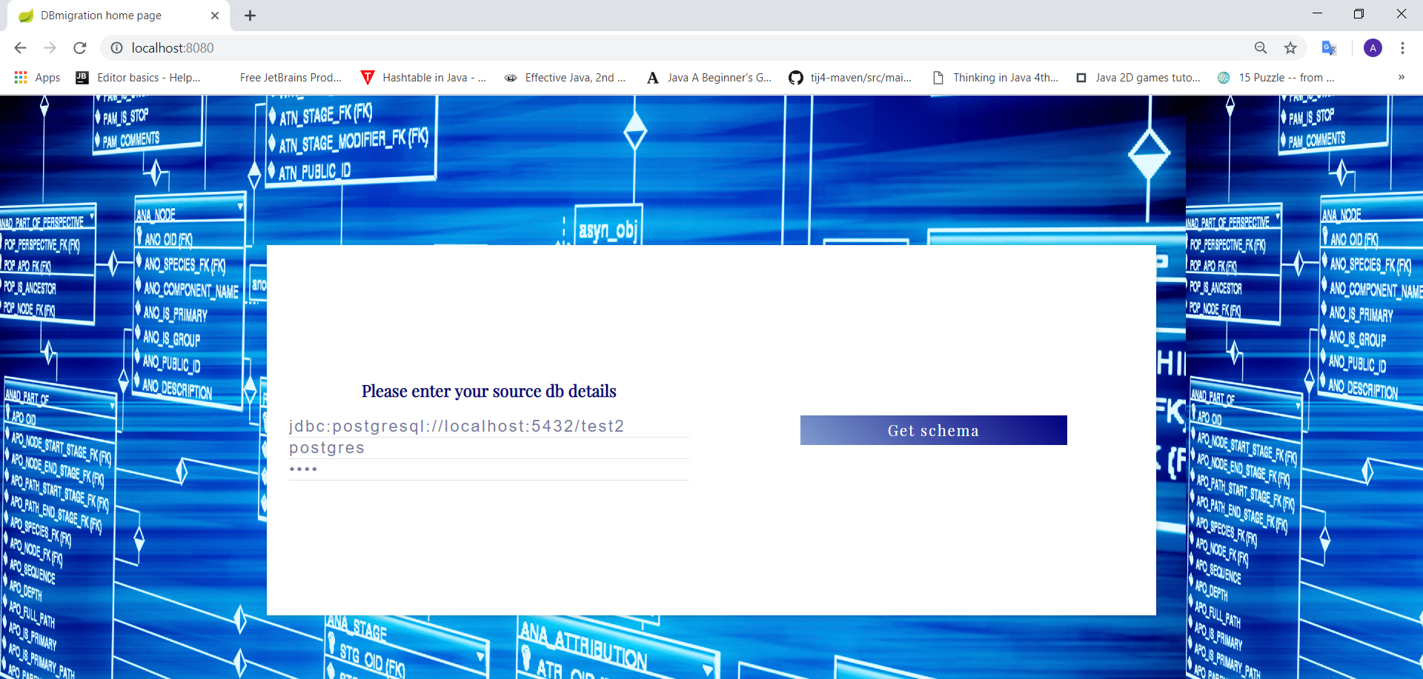
The final product First PAge

Slide 8
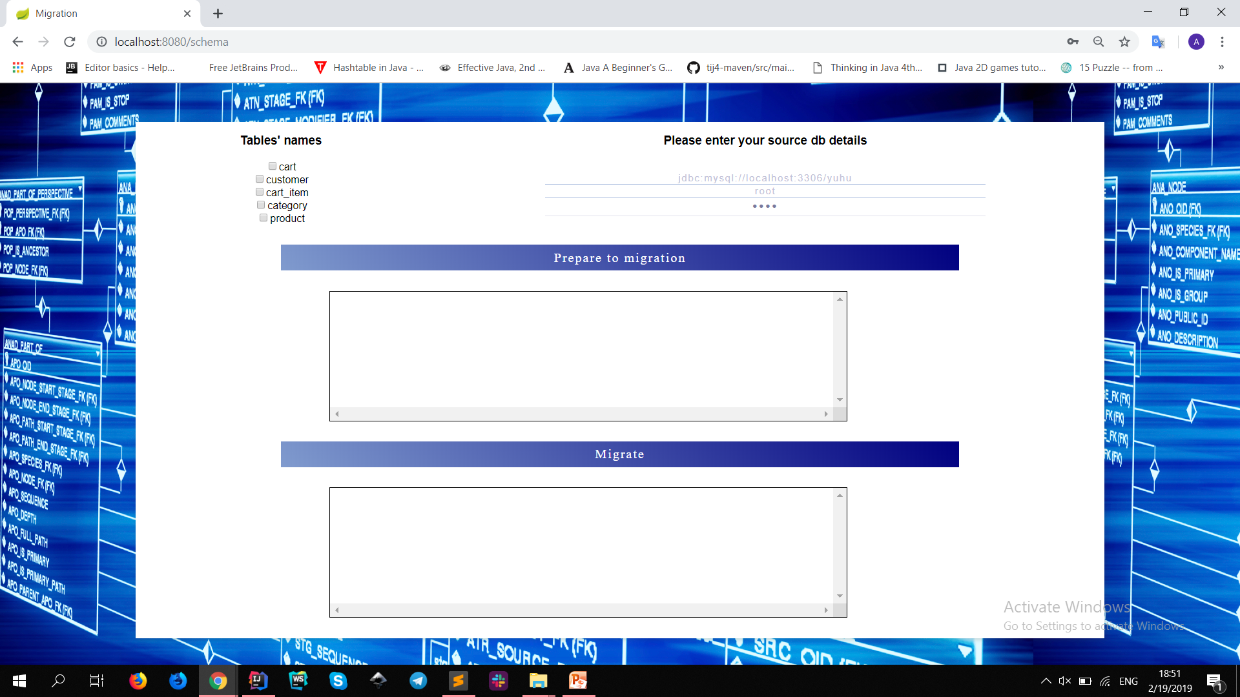
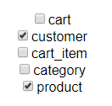
Main WorkIng Page

Slide 9
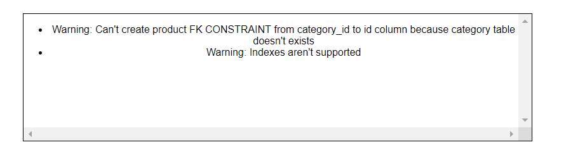

Warning Messages

Slide 10
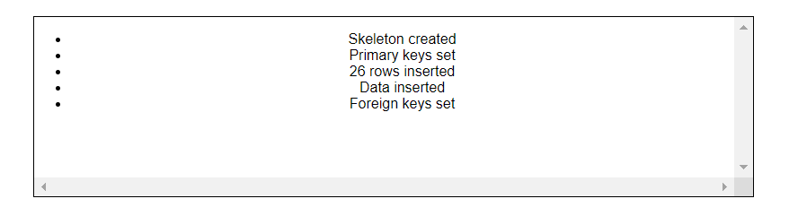
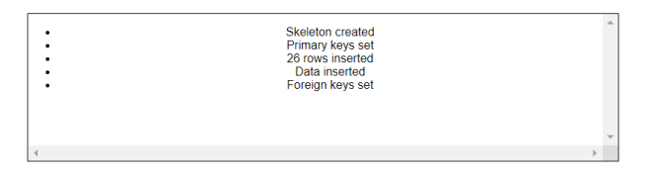
Migration process Messages

Slide 11
Further development
Support other RDBMSs
Oracle
MS SQL
...
Migrate
Views
Indexes
Functions
Sequences
Procedures
Triggers
Queues

Slide 12

Questions/Comments?

